Slide 1

Installing Python on Windows
By Divyendu Vikram Singh
Trained – by Shubham pal Singh (Automation Lead)

Slide 2
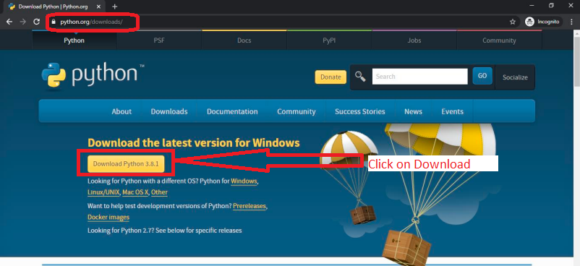
Installing Python on Windows
To download and install Python, go to Python's official website http://www.python.org/downloads/

Slide 3
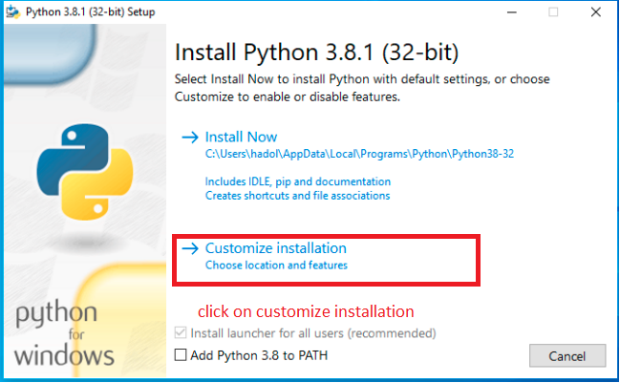
When download is complete run .exe file to install Python.

Slide 4
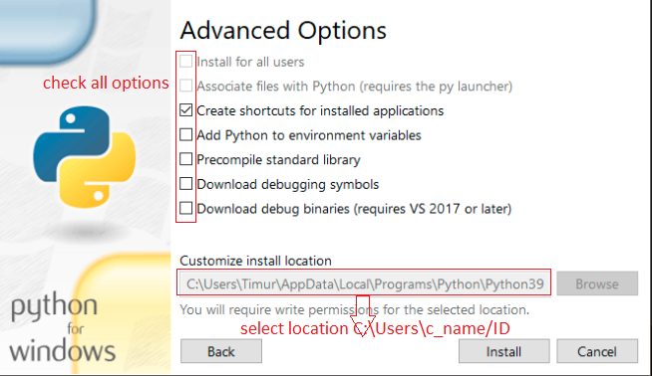
Customize install location

Slide 5
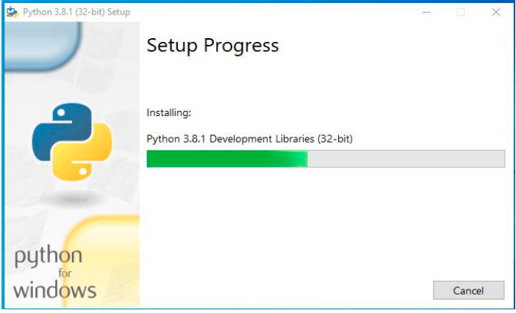
You can see python installation.

Slide 6
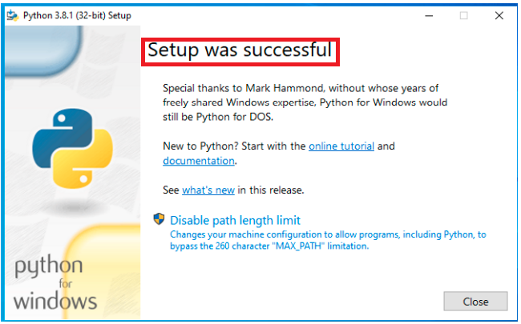
When installation was complete you can see message “setup was successful” on screen.

Slide 7
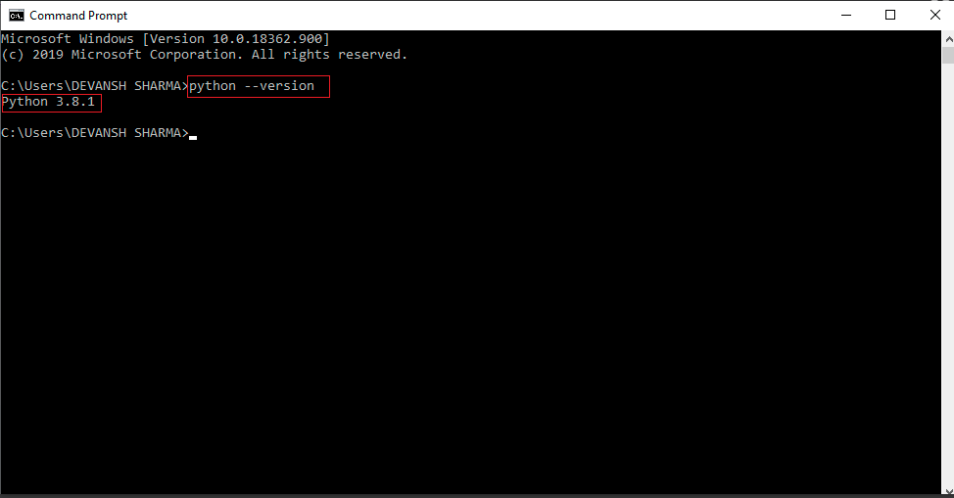
How to check Python version.
To check the Python version, open command line (Windows) and run python -version .

Slide 8
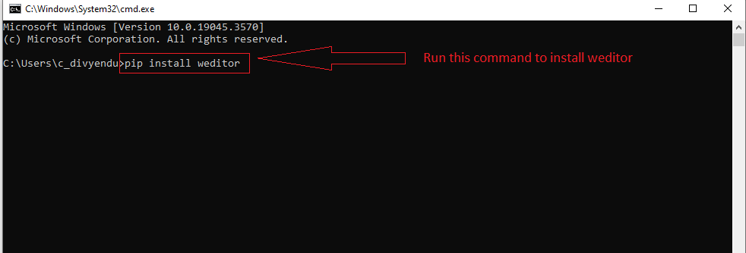
To install Weditor

Slide 9
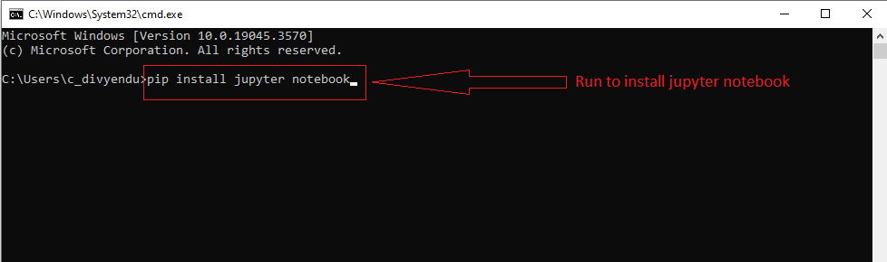
To install jupyter notebook

Slide 10
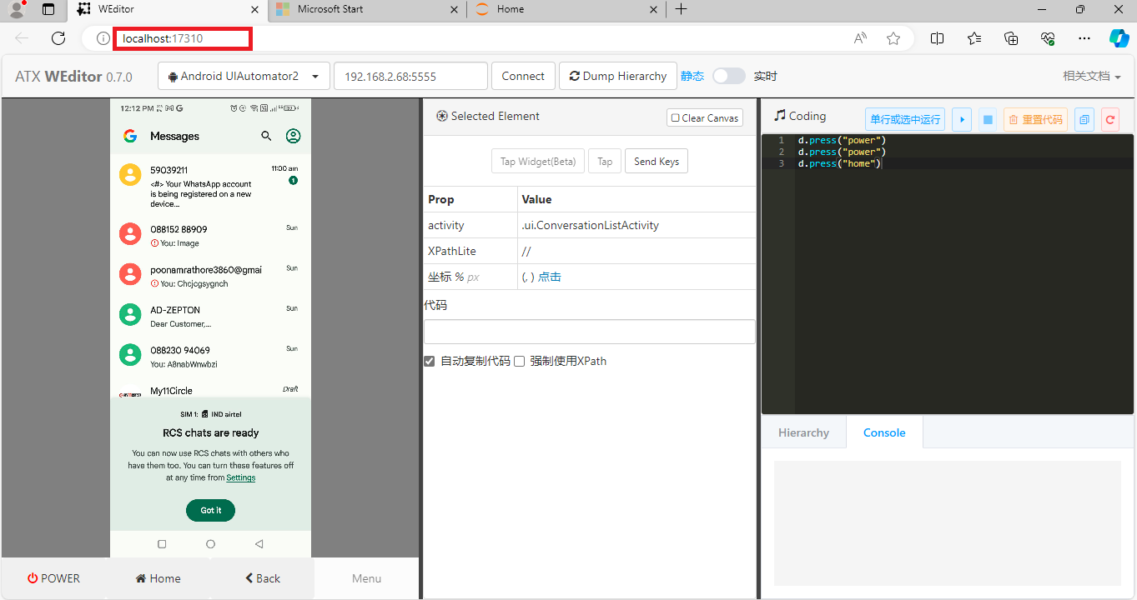
To run weditor
Open cmd in location C:\Users\c_divyendu.
Run command C:\Users\c_divyendu>weditor

Slide 11
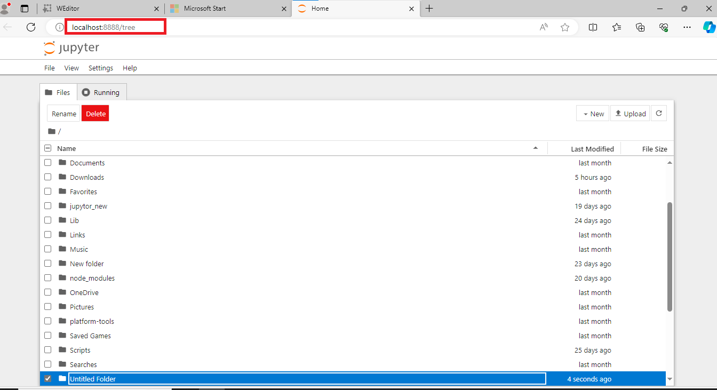
To run jupyter notebook
Open cmd in location C:\Users\c_divyendu
Run command C:\Users\c_divyendu>jupyter notebook
.

Slide 12
How to connect device through weditor.
Plug in USB and enable USB debugging port.
adb kill-server
adb start-server
“adb devices” This automatically starts the server. You should see the device plugged in via USB.
adb shell ip route show wlan0 to get your devices IP address.
adb tcpip 5555 Set the port to 5555 that you want to connect through.
adb connect 192.168.0.6:5555 Replace IP address with your IP address.

Slide 13
Error During Installation and setup
Local server not started, start with $ python -m weditor in weditor.
Weditor Not Recognized.
Start local server.
Add 'Scripts' to PATH issue.
Fix 'pip' not recognized.
Python environment is missing the pkg resources module, which is part of the setuptools package.

Slide 14
Thank you

